Slide 1
DS340 – Discussion Session
Course Instructor: Kevin Gold

Slide 2
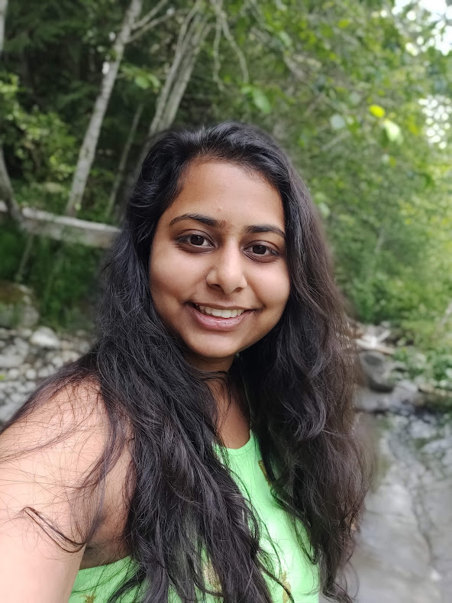



I’m Kashish!
Excited to be your TA!

Slide 3
Section Logistics
Discussion: every Thursday at 12:30-1:20PM
Start off with an overview of lecture or news concerning AI or lecture topics that week (which one?)
Transition into worksheets completed during discussion sessions
This section is required: while the worksheets are not graded, there is a participation grade.
However, if you can’t make it to the section, please email me and the professor ahead of time
My office hours will be posted by the end of this week on Piazza
Please come to me for help with anything: no judgement here! Everyone has different backgrounds and learning curves

Slide 4
Strengths and Weaknesses of AI
1. What do we know about the current state of AI and machine learning? What major successes can you remember, from either news stories or the first lecture?
2. Is there anything AI/ML seems to be bad at?
3. Can we speculate as to why AI/ML tends to be good at some things, but not others?
Notes:
5 minutes in the groups and then share out loud, freeform

Slide 5
The Elephant in the Room, ChatGPT (or similar)
1. What have you used ChatGPT, GPT-4, or another large language model for?
2. What have you heard about how ChatGPT works?
3. What are your opinions on how it ought to be used by students, versus misused?
4. Is this a case of AI researchers unleashing a technology on the world without adequately thinking of the consequences, or does it appear to be a net good?

Slide 6
Fears and Ethics
1. What do you worry *might* happen in AI and machine learning?
2. What can AI/ML people do to help ensure that none of that comes about?

Slide 7
Making It Personal
What field do you think of yourself as belonging to? (programming, pre-med, math, ...)
What do you, personally, hope to get out of this class?
If you got *really* good at AI/ML eventually, what would you do then?

Slide 8
Project Brainstorming
Once discussion of the above topics is complete, spend some time brainstorming possible projects in an AI/ML course with a person near you. Even if you're feeling stuck, try to be kind and help the other person generate ideas. If you get along well and think you could be project partners, exchange contact information.
Some things to think about as you brainstorm are:
Can you think of an interesting dataset that you know exists or ought to exist on the Internet?
Do you want to classify something, predict a value, or generate a new example? (The last one is harder than the others.)
How well do you expect humans would do this task? (If not well, the ML may not perform well, either.)

